Slide 1




HACKED- 3.0
“RFID System Real-Time Simulation”
Team “MITRA” (Code: C6)
Kunal Giri (Team Leader)
K.Anji Kumar
Kanisha

Slide 2
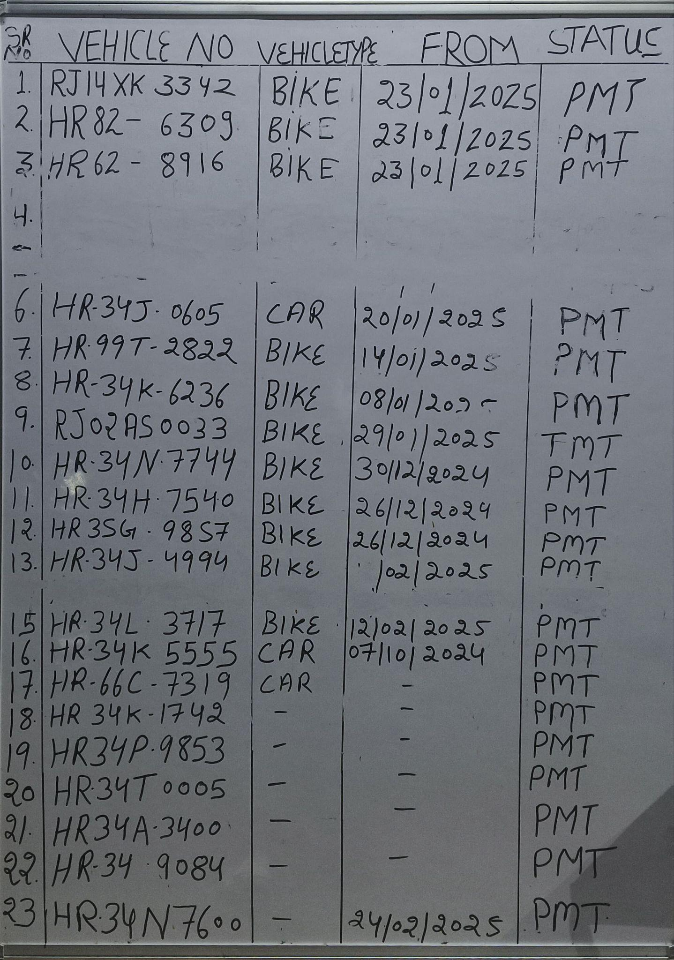
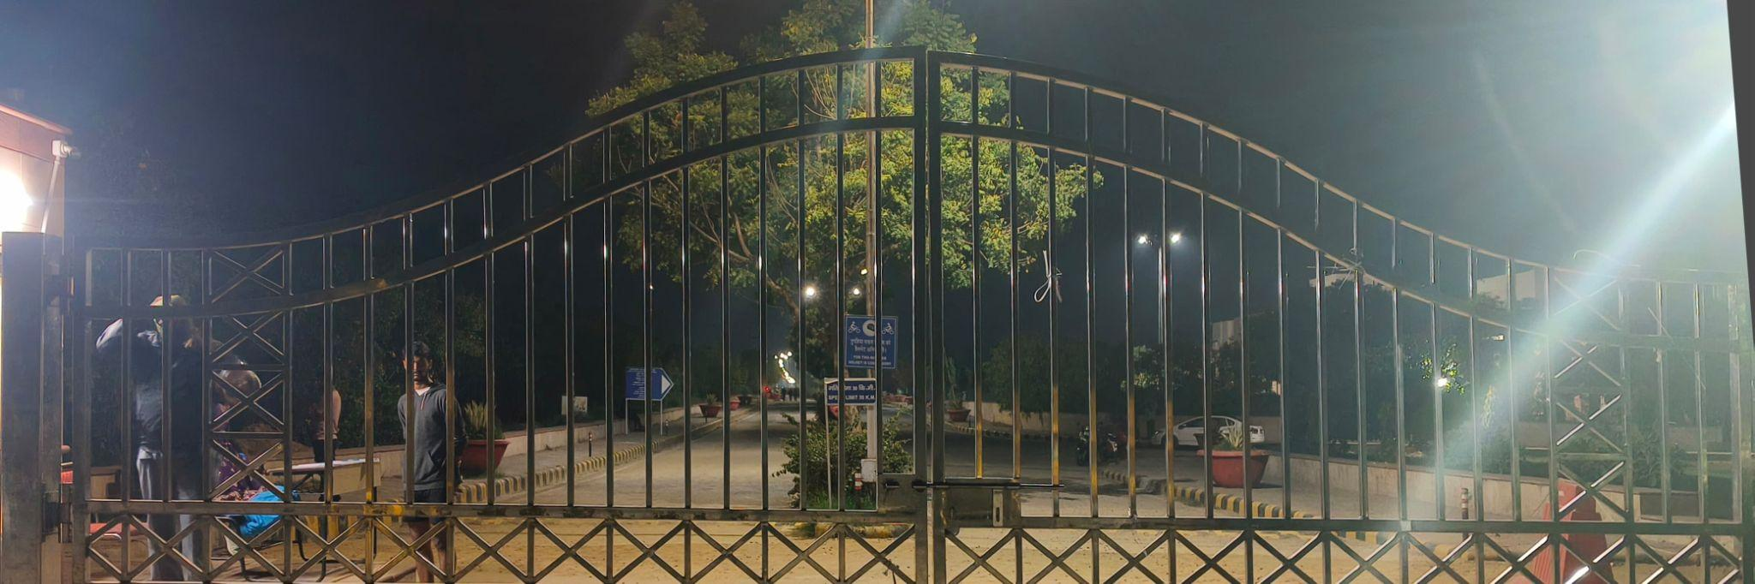
Title of the Innovation :- Automatic RFID ( Radio Frequency Identification ) Real-Time Simulation.
Origin of the Idea :- This idea of creating a RFID system came from an incident happened in our university, Central University of Haryana where some havoc was caused because of some unauthorized vehicles entering in the university premises. So, because of that, many vehicles got prohibited from entering in the campus and the security guards have to manually check all the details.
So, identifying this as a potential project idea we decided to convert this entire process of detecting, processing the check and then the result ( Access Granted/Denied ) completely automatically.

Slide 3
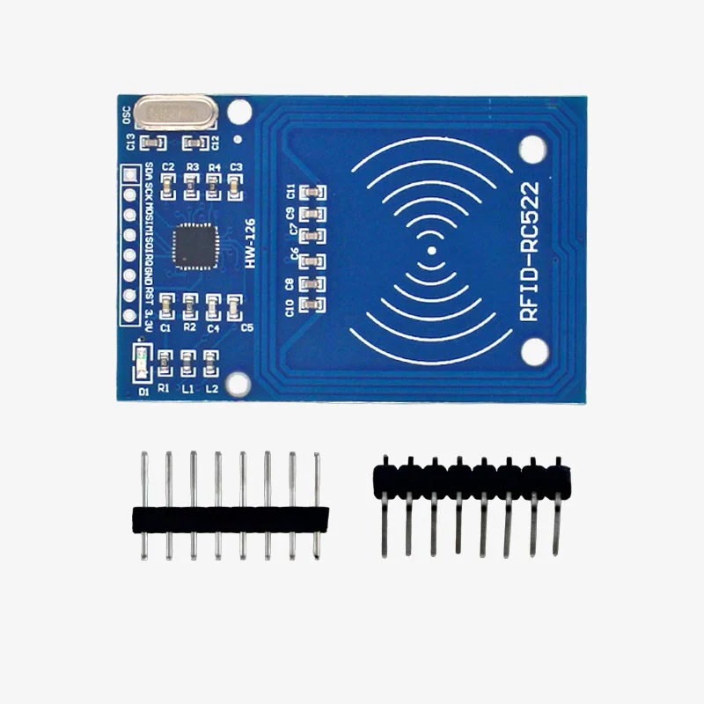

Problem Statement :- Automating the University’s Entry/Exit Security System and increasing the effectiveness of the system.
We will be installing the Stick Barricade along with our main gate and will install RFID Interface System, by which every vehicle in the university will be issued a card which will be having a radio frequency signal or even a QR or just an encoded text in the form of some scannable format.
The car will be entering the premises from the main gate where the scanner device will be scanning the unique I’d (in any format) on the card provided.
Secondly, as soon as the card is scanned the whole data of the vehicle along with the driver will be displayed on a monitor attached kin security room.
Every detail including any prohibition on vehicle or person will be shown along with the basic details of person along with the entering time stamps.

Slide 4
Limitations of Existing Projects :-
Existing method of storing records are very poor in efficiency and effectiveness.
A lot of manual/human involvements are present in available version.
Extracting individual or specific data is very complex.
In most areas, the Stick Barricades is not connected with the automated system and needs to be opened/closed manually.
Notification feature is either not present or is very slow, eventually leading to thefts or mishappenings.
Benefits of Team MITRA’s model :-
The way of Data Storing, Processing and Fetching is very much more accurate and efficient than today’s used methods.
Fully Automatic, almost negligible human intervention.
Our model gives you a notification via SMS whenever your vehicle is checked out/in, within 5 secs, so that you have a clear idea of who is using your stuffs and for what.
This system (RFID Card System) can easily be made the part of university’s culture, so that the issues caused because of the lack of this system reduces fast.
Cost Effecient : In existing models, costly modules are used and unnecessary fee is charged, but in our model by using simple electronic components like Relay instead of costly modules we can make the model in less budget (at least 2-4 times).

Slide 5
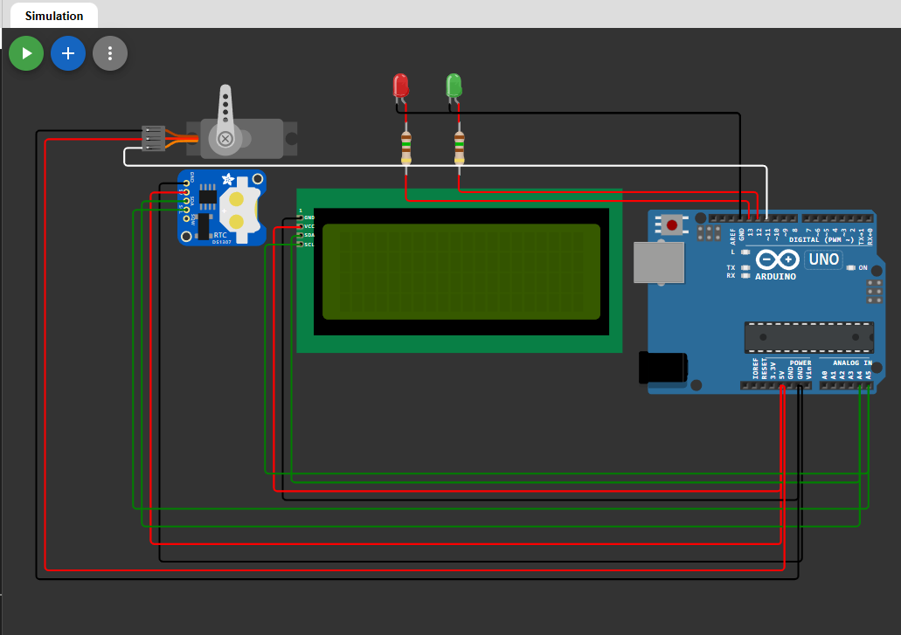
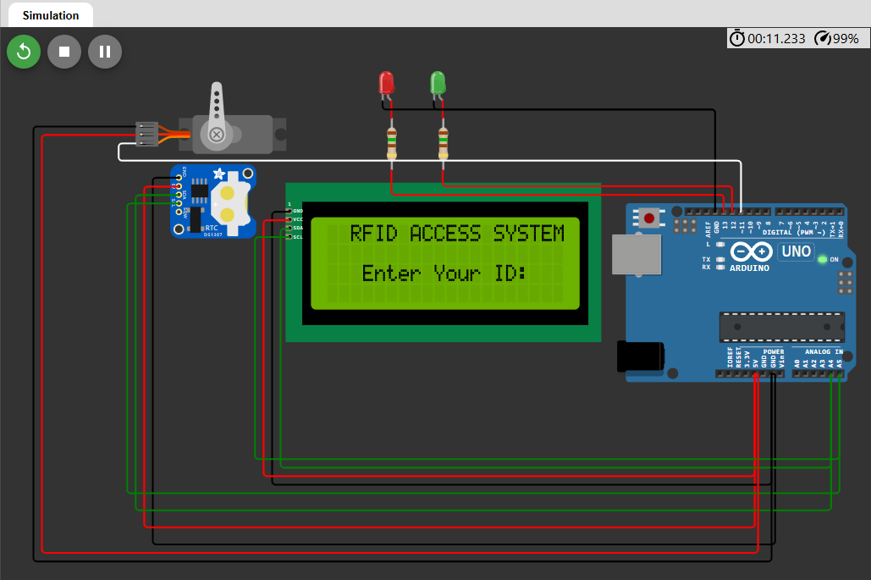
Components Used :-
Arduino Uno
Servo Motor → To mimic the Stick Barricade in the simulation
RTC Module DS1307 → For sensing the time of check-in/check-out
LCD (20X4) → For displaying data
LEDs → Green : For Indicating “Access Granted !”
Red : For Indicating “Access Denied !”
Resistors (150Ω X 2) → For smooth functioning of LEDs

Slide 6
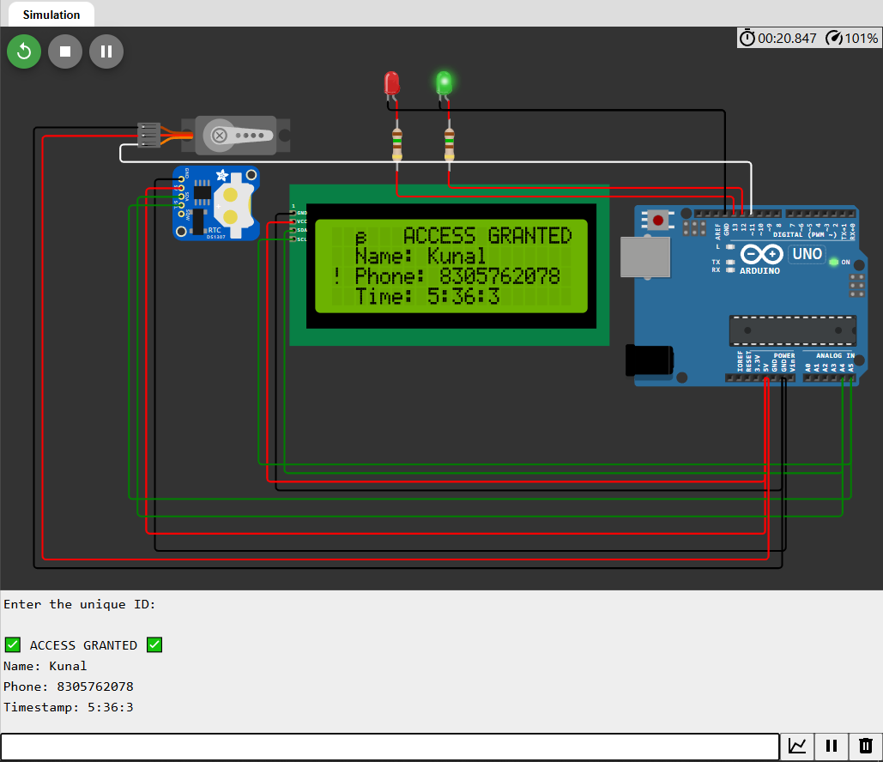
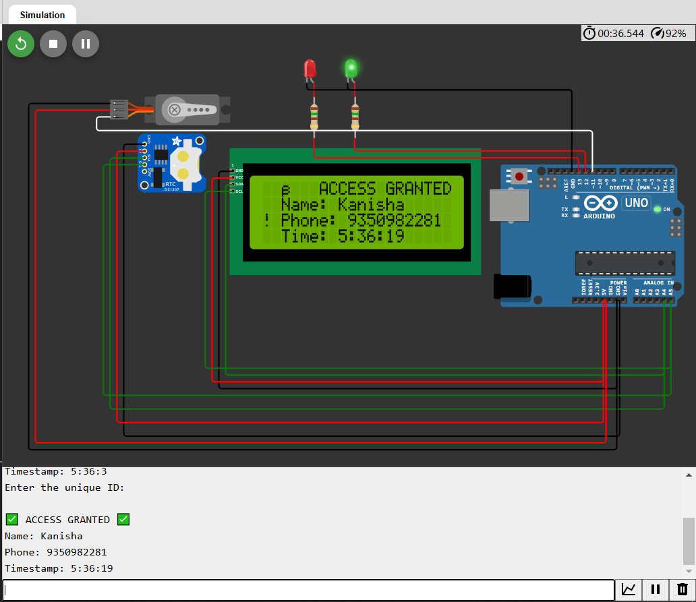
Python Application for the same :-
To show the smooth working of all the features of the project, we made a python application in which using Tkinter library we created a GUI Interface which gives a Real-Time experience of the concept. This python application lets you experience the Notification via SMS feature of the project live.

Slide 7
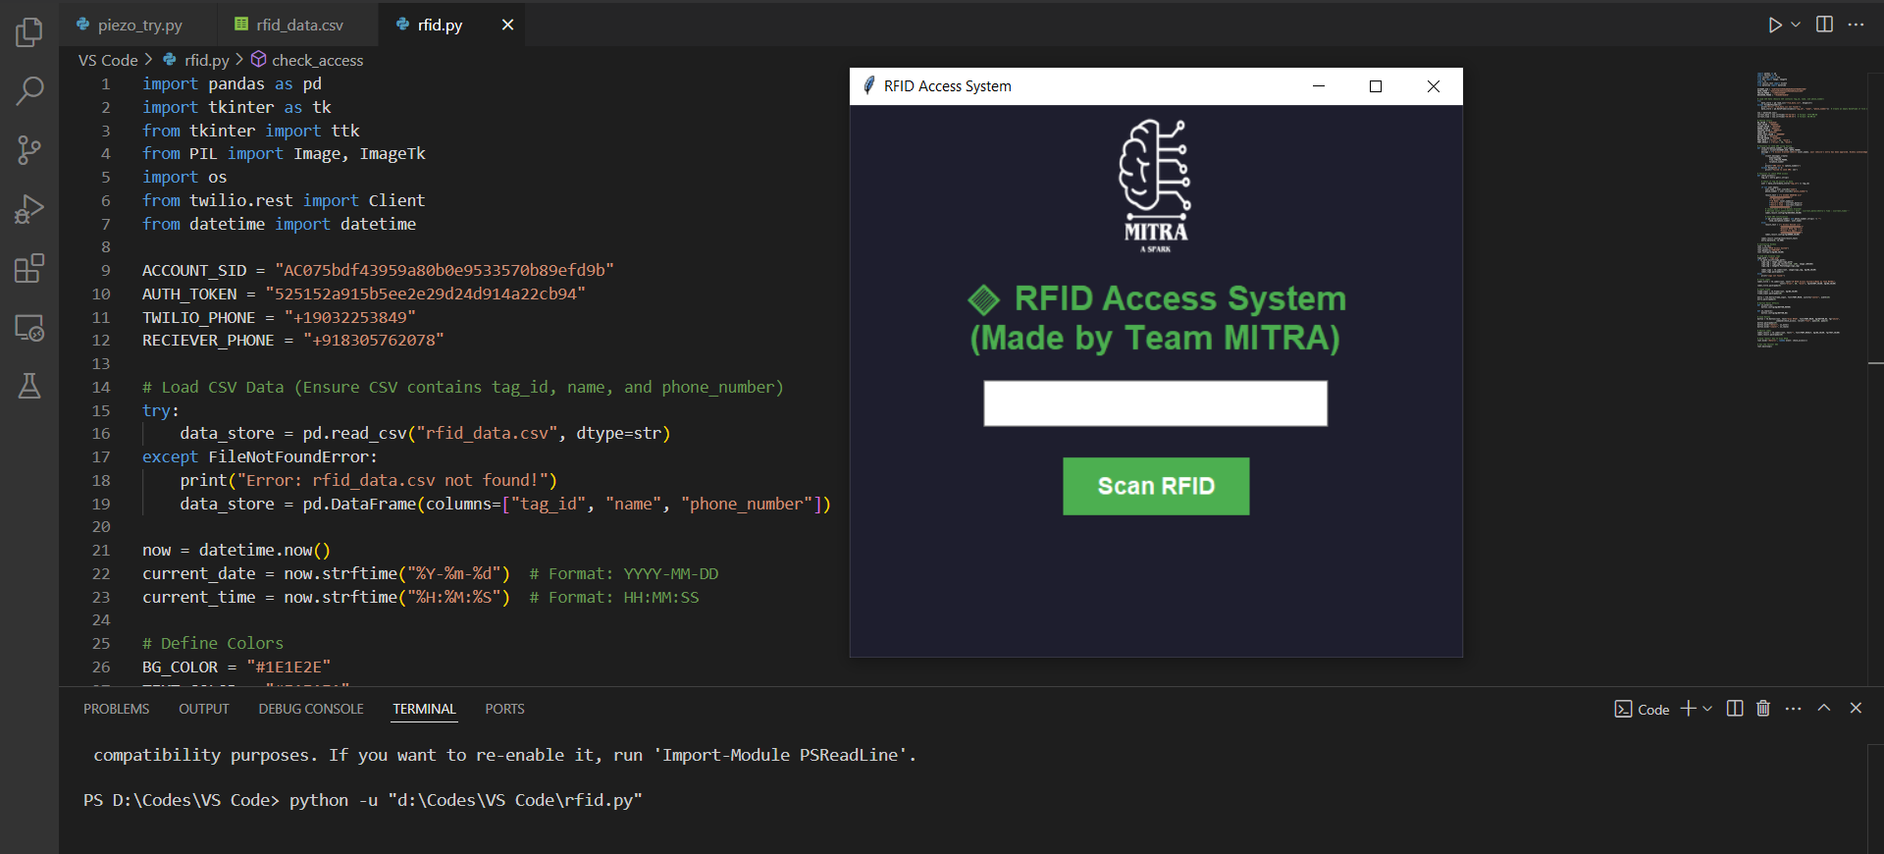
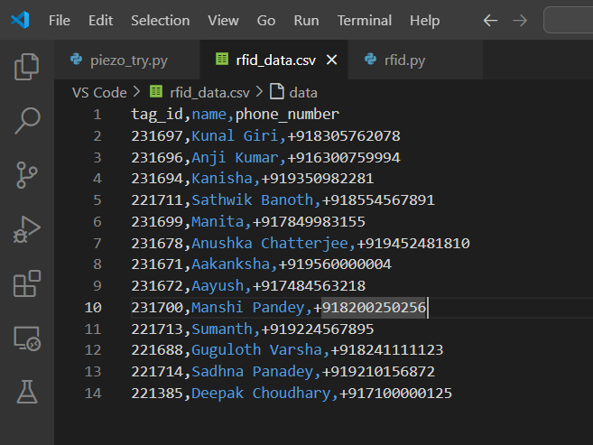
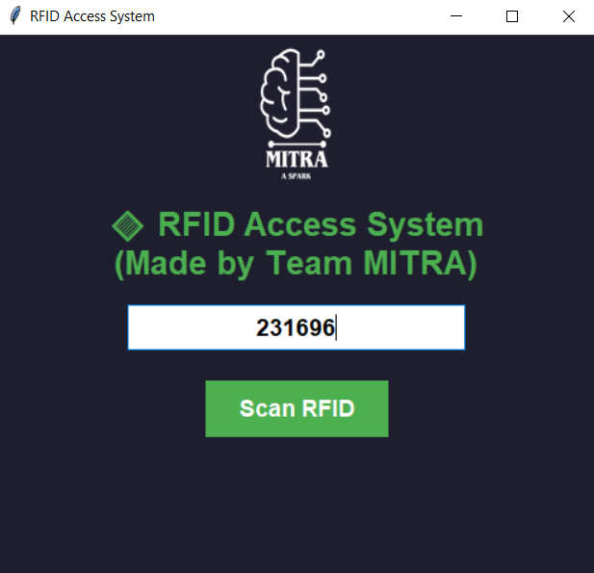
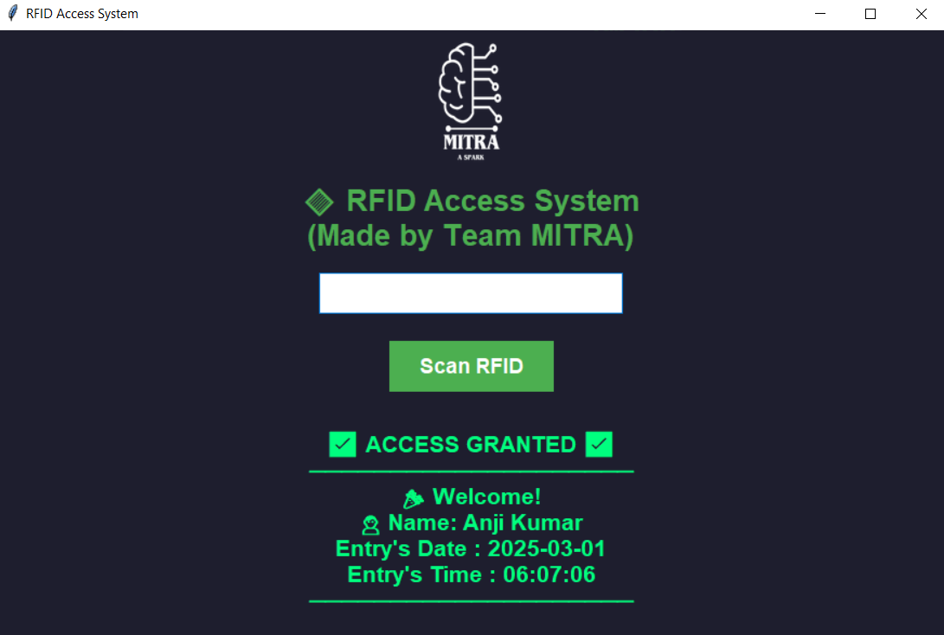

Slide 8


